Slide 1
Portfolio Optimization: Markowitz Model

Slide 2
Portfolio Optimisation
Modern Portfolio Theory ^{[1]}
Classical Markowitz Mean Variance^{[2]} Optimization
Black Litterman Models
Henry Markowitz - 1952
CRITICAL LINE ALGORITHM (CLA)
Portfolios are selected as follows;
From the portfolio that have the same return, the investor will prefer lower risk
From the portfolios that have the same risk level, an investor will prefer the portfolio with the higher rate of return

Slide 3
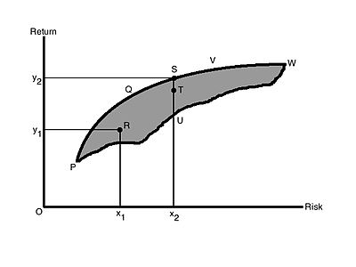
Mean Variance Model
X = Mean Expected Return
Y = Standard Deviation^{[1]} (root squared mean of variance) of the various portfolio

Slide 4
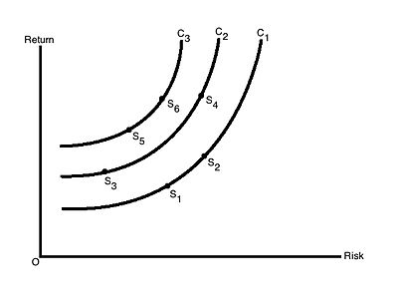


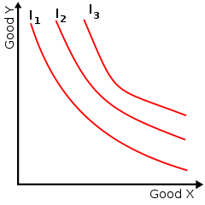
Risk Return Indifference Curve
Indifference curve connects points on a graph representing different quantities of two variables

Slide 5
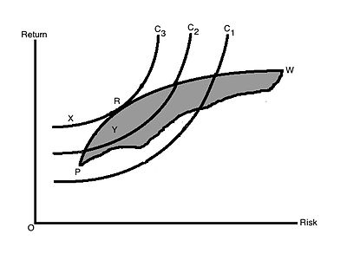
THE EFFICIENT PORTFOLIO

Slide 6
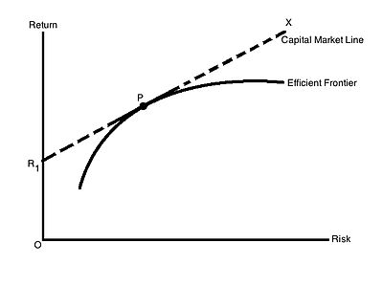
The Combination of Risk Free Securities with the Efficient Frontier and Capital Market Line

Slide 7
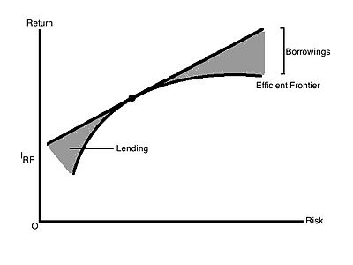
Capital Market Line and Risk Free Lending and Borrowing

Slide 8
To build our best portfolio, we need to;
Determine the efficient set
Choose the best portfolio using indifference curve and efficient frontier
Risk Free Rate return to build our lending portfolio
Borrow some funds at Risk Free Rate to buy more portfolio P

Slide 9
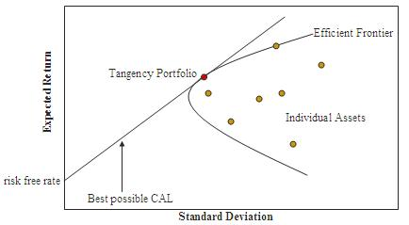
The efficient frontier or portfolio frontier is an investment portfolio which occupies the ‘efficient ‘ parts of the risk return spectrum.
Henry Markowitz developed a special algorithm called the Critical Line Algorithm (CLA) for developing the portfolio frontier. However, the algorithm comes with its own set of caveats
The CLA Algorithm can change significantly for small changes in market correlations^{[1]}
CLA is very depended on the estimation of stock-returns which is very hard to estimate with sufficient accuracy. This makes it hard to quanitfy the results of this algorithm
CLA considers the correlations between the return of all the assets in a portfolio and this leads to very large correlation dependency connected graph.
CLA is unstable to the volatility of the stock market.

Slide 10
All the disadvantages of CLA make CLA is unsuitable for practical applications.
This is where Hierarchical Risk Parity (HRP) by Marcos Lopez de Prado comes and improve upon them.

Slide 11
The HRP algorithm is computed throughout 3 main steps:
1. Hierarchical Clustering - breaks down our assets into hierarchical clusters
2. Quasi-Diagonalization - reorganizes the covariance matrix, placing similar assets together
3. Recursive Bisection - weights are assigned to each asset in our portfolio

Slide 12
Does HRP have any disadvantage in building our best portfolio?
Hierarchical Risk Parity starts by reorganizing the covariance matrix to place similar investments together. Then it employs an inverse variance weighting allocation based on the number of assets with no further use of the clustering. HRP aims at diversifying risk allocation.
However, the chosen weighting scheme in HRP does not take risk into account, which can be problematic. Indeed, even if portfolios are diversified in terms of capital allocation, portfolios may be heavily concentrated in terms of risk allocation.
HRP also depends on the correlation between assets. From the theorical point of view, it seems more appropriate to make no assumptions on the correlation between clusters.

Slide 13
Yes, HRP algorithm have following drawbacks
HRP is based on the equivalence between Hierarchical Tree Clustering and the single linkage clustering algorithm. On the other hand, single linkage suffers from chaining. In order to merge two groups, only one pair of points need to be close, irrespective of all others. Therefore, clusters can be too spread out and not compact enough.
Hierarchical Tree Clustering is only used to reorder the assets. The shape of dendogram is not considered when the bisection is done. Only the number of assets matters.
The relevant number of clusters is not considered. Each asset is its own cluster. It may happen that we use more information then the clustering can provide with reliability. Intuitively, it can be seen as a form of overfitting, leading to potential bad results.
HRP used variance as the most common the risk metric. While variance is a good measure of risk, it is not good measure for the risk of assets with significant tail risk.

Slide 14
That’s why Thomas Raffinot in his paper
“ Hierarchical Clustering Based Asset Allocation” introduced Hierarchical Equal Risk Contribution (HERC) and improved Hierarchical Risk Parity (HRP)

Slide 15
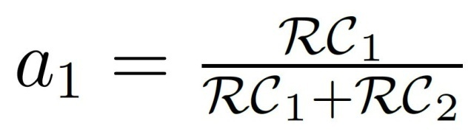
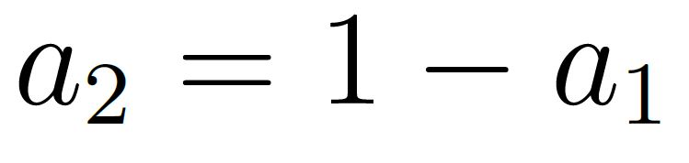
Hierarchical Equal Risk Contribution Portfolio (HERC)
HERC aims at diversifying capital allocation and risk allocation. It computes in four stages;
Hierarchical Clustering
Selection of the Optimal Number of Clusters based on the Gap Index
Top Down recursive division into two parts based on the dendogram and following an Equal Risk Contribution Allocation. The weights are
Where RC 1 is the Risk Contribution of the first cluster and RC2 is the risk contribution of the second cluster.
Naïve Risk Parity within clusters (with the same cluster the correlation between assets should be elevated

Slide 16
Exploratory Data Analysis
60 of 689 public companies (25 of 60 public companies with preferred financial statement method portfolio selection) with good financial health
Profiling Portoflio Allocation without K-Means Clustering
HRP
HREC
With K-Means Clustering
HRP
Inverse Variance
BCRP Strategy
HREC
Inverse Variance
CLA Algorithm
Workflow Review

Slide 17
Evaluation Metrics ^{[1] [2]}
Conditional Drawdown at Risk Metrics – The average of all drawdowns or cumulative losses in excess of a certain threshold
Expected Shortfall Risk Metrics – The expected return on the portolio in the worst q% of cases
Variance at Risk Metrics – The estimator how much a set of investments might lose (with a given probability), given a normal market conditions, in a set time period.
Sharpe Ratio – The average return earned in excess of the risk free rate per unit of volatiity or total risk
Probabilistic Sharpe Ratio - The probability that the estimated Sharpe Ratio exceeds a benchmark Sharpe Ratio
Information Ratio – The portfolio return beyond the returns of the a benchmark, usually an index, compared to the volatility of those returns
Minimum Record Length – The time period how long a track record should be in order to have statistical confidence that its Sharpe rato is above a given threshold
Bets Concentration - The uniformity of returns from bets. The closer the concentration is to 0, the more uniform the distribution of returns.

